Slide 1
BPIPE
A framework to launch bioinformatic pipelines

Slide 2
Motivation
Architecture
Resource managers
Notifications and Emails
Some examples

Slide 3
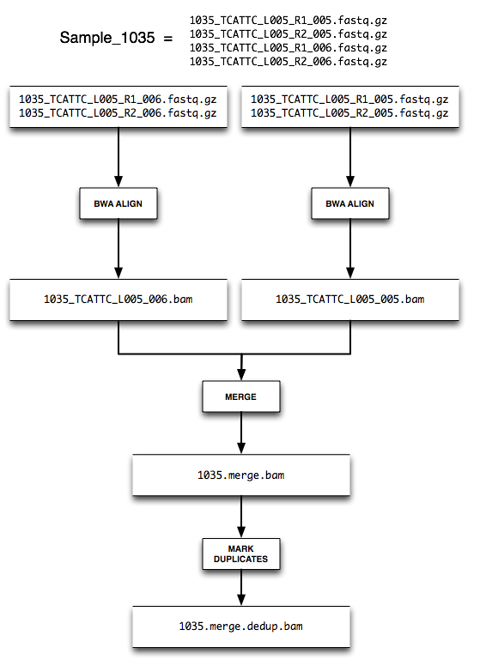
A DNA alignment for a single sample:

Slide 4
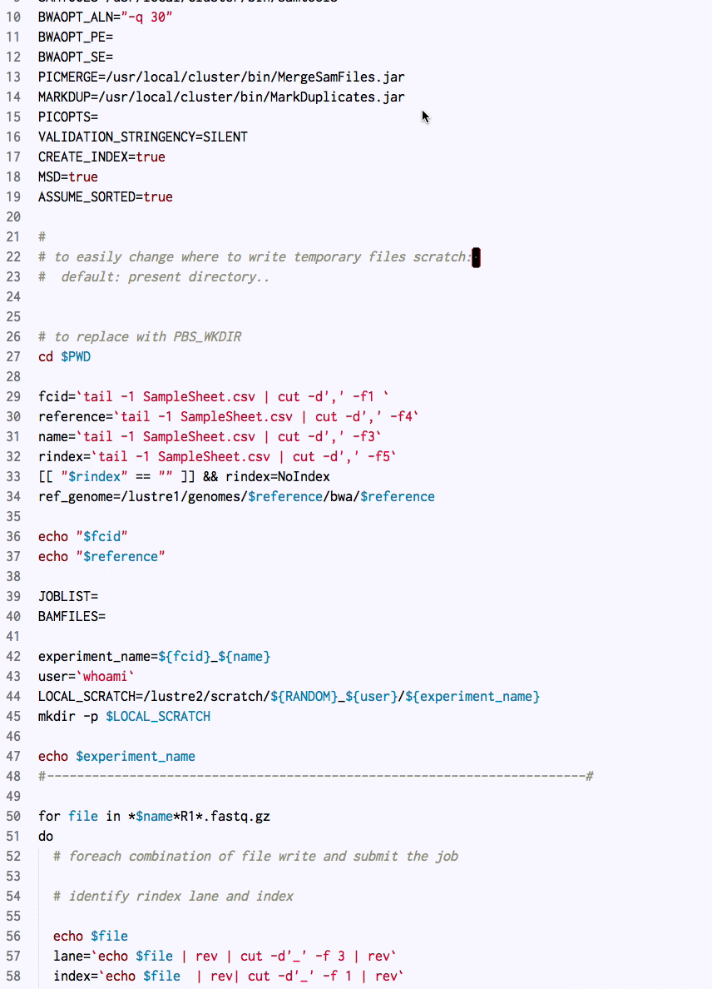
bwa_submit_lane.sh
the script don’t solve some critical questions:
What if single command fails during pipeline execution?
How can I know if the pipeline completes without errors?
What if tomorrow I change queue system on the cluster?

Slide 5
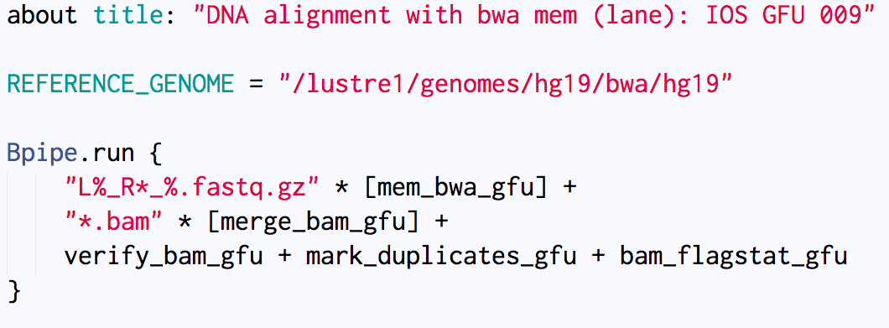
bwa_submit_lane (bpipe version)
Single stages (es: mem_bwa_gfu) are loaded from an external file (BPIPE_LIB)

Slide 6
What if a single command fails during pipeline execution?
Transactional management of tasks:
commands that fail get outputs cleaned up, log files saved and the pipeline cleanly aborted.
With bpipe retry we can restart from the last valid intermediate file
How can I know if the pipeline completes without errors?
Audit Trail:
Bpipe keeps a journal of exactly which commands executed and what their inputs and outputs were (commandlog.txt).
bpipe log will stream the output from the job continuously to your console.
What if tomorrow I change queue system on the cluster?
Resource managers:
if you use Torque PBS, PBS Pro, Oracle Grid Engine or Platform LSF then Bpipe will make your life easier by allowing pure Bpipe scripts to run on your cluster virtually unchanged from how you run them locally.

Slide 7
Motivation
Architecture
Resource managers
Notifications and Emails
Some examples

Slide 8

what’s inside the box?
bpipe provides a platform for running big bioinformatics jobs that consist of a series of processing stages - known as ‘pipelines'. Inside the box you will find:
the bpipe language (DSL) A small language for defining pipeline stages and linking them together to make pipelines
the bpipe command line utility An utility for running and managing the pipelines you define

Slide 9
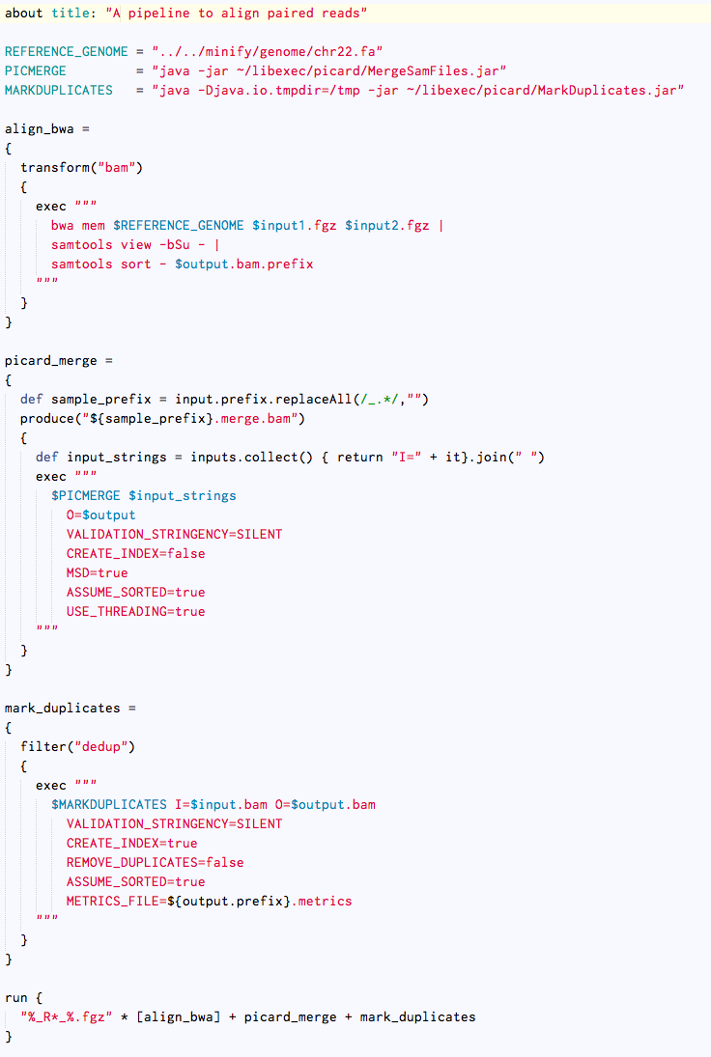
bpipe language
Pipeline title
GLOBAL VARS
Stage
A stage is a small piece of code with a name (closure).
Stage
We can define variables in a stage
(see: def sample_prefix).
The exec keyword runs the command specified as an argument using a bash shell in a managed fashion.
Stage
The run keyword tells bpipe to join together the stages and launch the pipeline
Run

Slide 10

bpipe: pipeline and stages
Pipeline
Stage

Slide 11
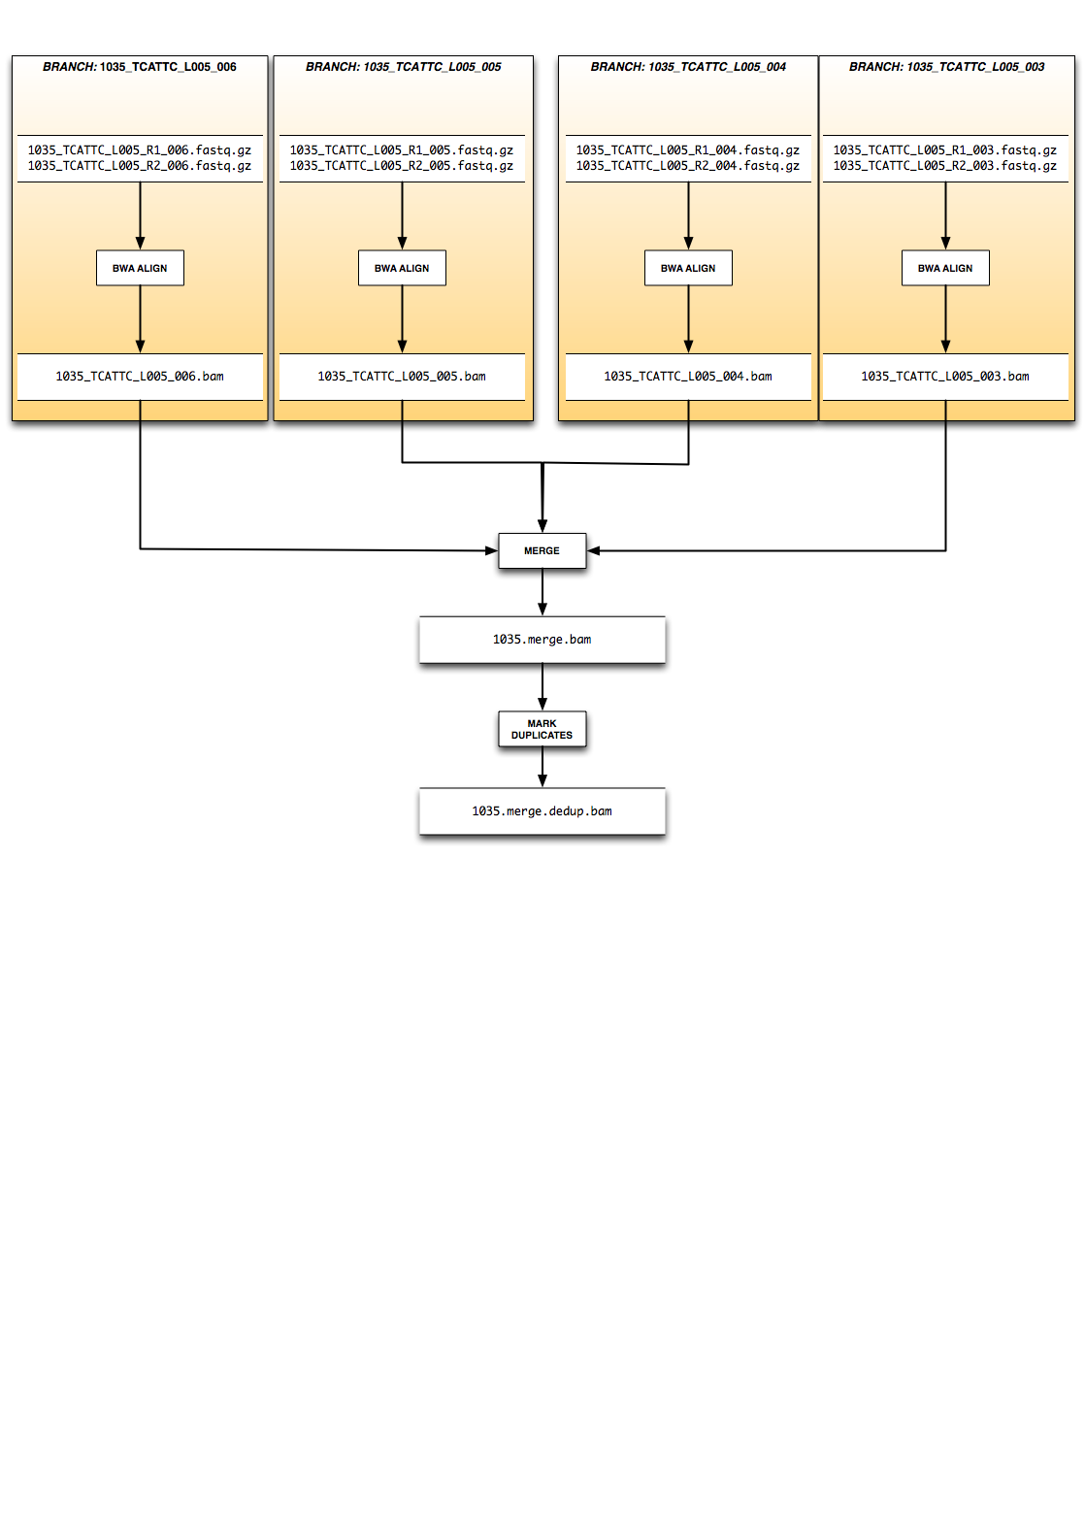
BPIPE: branches

Slide 12
bpipe language (DSL) is a groovy”dialect” with special keywords
input
prefix
requires
dir
output
transform
branch
multi
exec
produce
load
chr
check
filter
uses
fail
var
file
succeed
R
forward

Slide 13
bpipe command line utility
Bpipe Version 0.9.8.6_rc2 Built on Mon Sep 01 10:42:49 CEST 2014
usage: bpipe [run|test|debug|execute] [options] <pipeline> <in1> <in2>...
retry [test]
stop
history
log
jobs
checks
status
cleanup
query
preserve
diagram <pipeline> <in1> <in2>...
diagrameditor <pipeline> <in1> <in2>...
-d,--dir <arg> output directory
-f,--filename <arg> output file name of report
-h,--help usage information
-L,--interval <arg> the default genomic interval to execute
pipeline for (samtools format)
-l,--resource <resource=value> place limit on named resource
-m,--memory <arg> maximum memory
-n,--threads <arg> maximum threads
-p,--param <param=value> defines a pipeline parameter
-r,--report generate an HTML report / documentation
for pipeline
-R,--report <arg> generate report using named template
-t,--test test mode
-u,--until <arg> run until stage given
-v,--verbose print internal logging to standard error
-y,--yes answer yes to any prompts or questions

Slide 14
Running bpipe pipelines
bpipe run align.groovy *.fastq.gz
bpipe dynamically compile your pipeline as a groovy class.
====================================================================================================
| Starting Pipeline at 2014-09-01 13:57 |
====================================================================================================
================================== Stage align_bwa [sample1_L001] ==================================
================================== Stage align_bwa [sample1_L001] ==================================
================================== Stage align_bwa [sample1_L001] ==================================
================================== Stage align_bwa [sample1_L001] ==================================
======================================== Stage picard_merge ========================================
====================================== Stage mark_duplicates =======================================
======================================== Pipeline Finished =========================================
13:57:19 MSG: Finished at Mon Sep 01 13:57:19 CEST 2014
13:57:19 MSG: Output is sample1.merge.dedup.bam
bpipe log
bpipe retry
bpipe query
bpipe cleanup

Slide 15
bpipe fails
Bpipe consider a stage failed if:
The exit status is greater than 0
The command was interrupted (Kill or Ctrl-C)
bpipe is unable to find the output file
In order to ensure that bad data (corrupt or failed outputs) never get confused with good data, output from failed stages are moved in the Trash directory (.bpipe/trash)

Slide 16
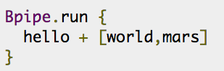
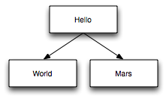
Parallel Tasks
Executing Multiple Stages Simultaneously on the Same Data

Slide 17
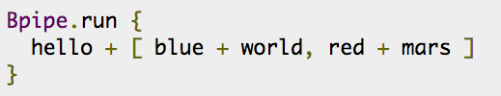
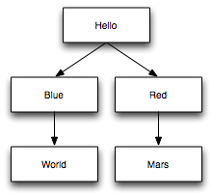
Parallel Tasks
Executing Multiple Stages Simultaneously on the Same Data

Slide 18
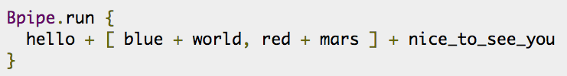
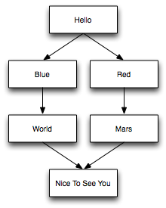
Parallel Tasks
Executing Multiple Stages Simultaneously on the Same Data

Slide 19
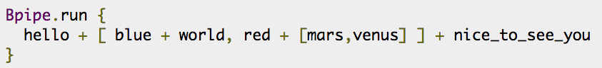
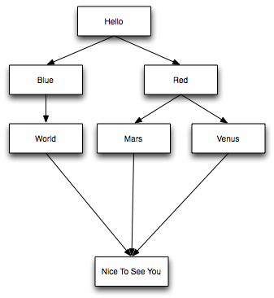
Parallel Tasks
Executing Multiple Stages Simultaneously on the Same Data

Slide 20
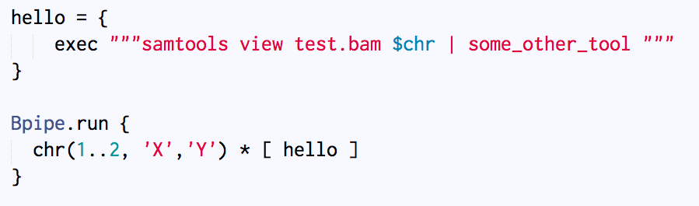
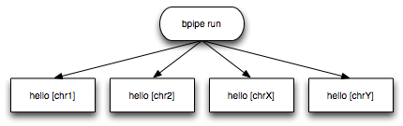
Parallel Tasks
Parallelizing Based on Chromosome

Slide 21
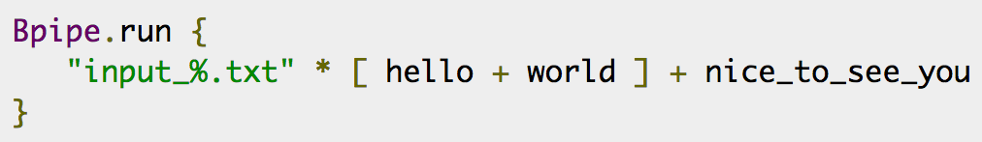
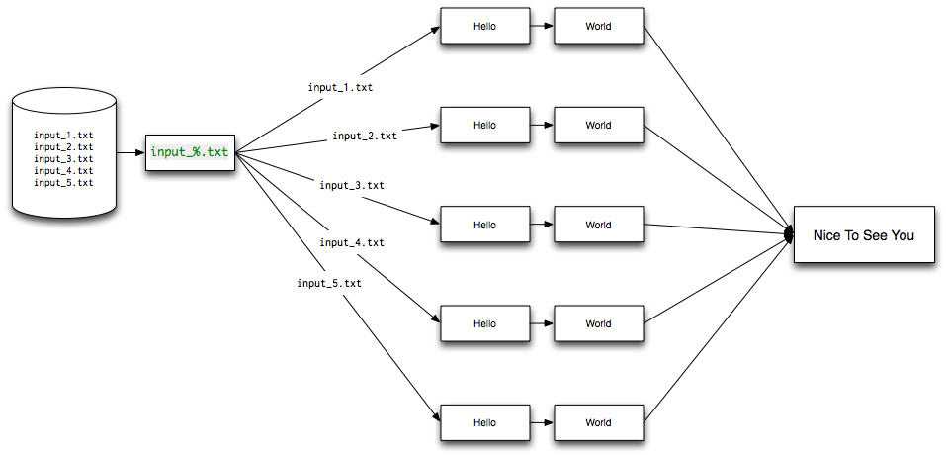
Parallel Tasks
Executing Multiple Stages Simultaneously on Different Data

Slide 22
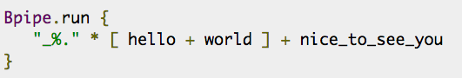
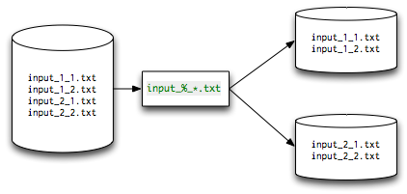
Parallel Tasks
Input Splitting Patterns: % and *
The pattern matching used for grouping files is a substring match. Therefore you only need to supply enough of the input file name to uniquely identify where the grouping character is.
This means Bpipe will look for the first (and shortest) token in the file name that is flanked by an underscore on the left and a period (. character) on the right.
Bpipe supports one other special character in its input splitting patterns: the * wildcard
This also acts as a wildcard match but it does not split the input into groups.
Instead, it affects ordering within the groups that are split.

Slide 23
Motivation
Architecture
Resource managers
Notifications and Emails
Some examples

Slide 24
Local run
bpipe run align.groovy *.fastq.gz
Each command runs locally

Slide 25
Cluster run
In some environments commands cannot be issued directly but must be queued and run in a managed environment that controls how long they can run for and what resources (memory, CPU, storage space, etc) they can use.
executor=“torque”
bpipe run align.groovy *.fastq.gz
Each command runs on cluster (torque)

Slide 26
Cluster run: behind the scene
For each stage bpipe do the following:
Create a qsub script
Execute the script with qsub
Monitor the execution with qstat
Notify when the job complete (qstat)
Verify presence of output files
executor=“torque”
bpipe run align.groovy *.fastq.gz
Each command runs on cluster (torque)

Slide 27
Cluster run: behind the scene
.bpipe
|-- checks
|-- commands
|-- commandtmp
|-- executed
|-- inprogress
|-- jobs
|-- launch
|-- logs
`-- outputs
.bpipe/commandtmp/
|-- 1
|-- 11
|-- 12
|-- 13
`-- 84
#!/bin/bash
#PBS -N soapsplice_prep
#PBS -q workq
#PBS -o /lustre2/scratch/Martelli/152_RISCIP_RUN175/.bpipe/commandtmp/84/84.pbs.log
#PBS -e /lustre2/scratch/Martelli/152_RISCIP_RUN175/.bpipe/commandtmp/84/84.pbs.err.log
#PBS -P Martelli_152_RISC_IP_MD
#PBS -A drambaldi
#PBS -l select=1:ncpus=4:mem=32g
cd $PBS_O_WORKDIR
(COMMAND HERE)> .bpipe/commandtmp/84/84.out 2> .bpipe/commandtmp/84/84.err
.bpipe/commandtmp/84/
|-- 84.err
|-- 84.out
|-- 84.pbs.err.log
|-- 84.pbs.log
`-- job.pbs

Slide 28
Motivation
Architecture
Resource managers
Notifications and Emails
Some examples

Slide 29
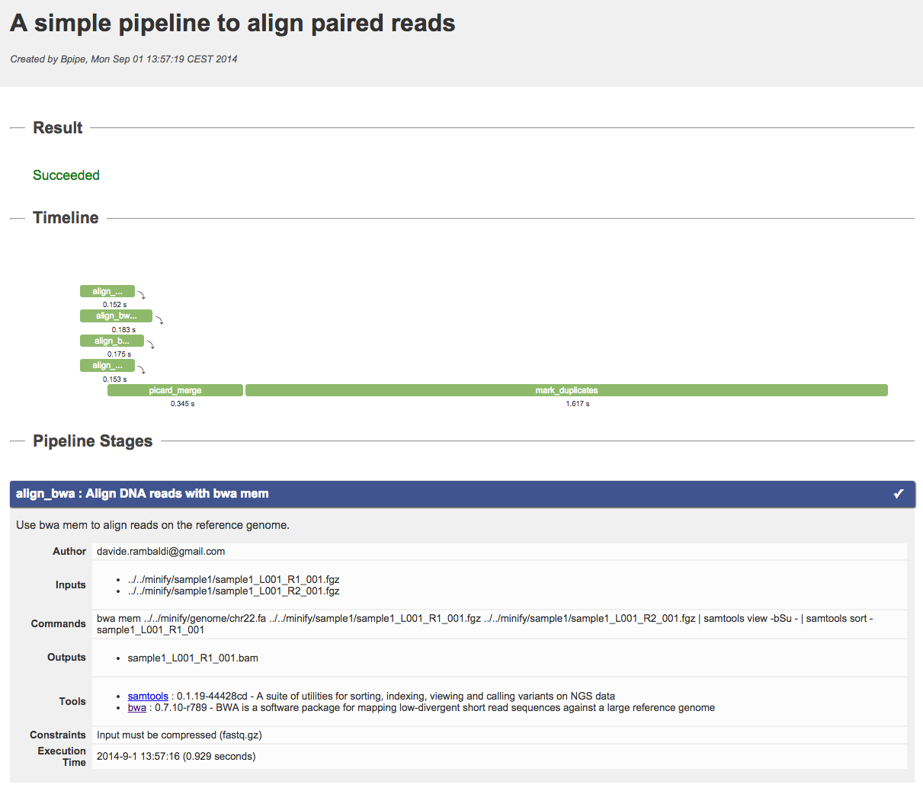
HTML report

Slide 30
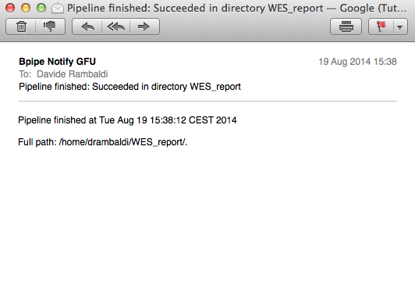
Email notifications
Bpipe can send emails and chat messages
on Pipeline/Stage competition

Slide 31
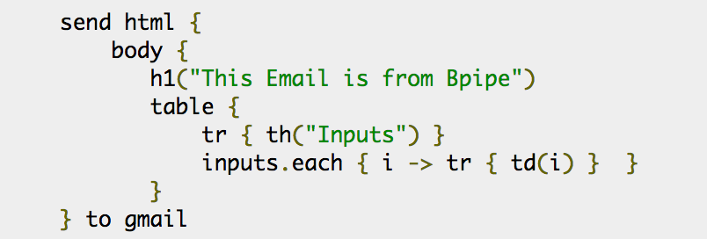
Email notifications
With the keywords send, succeeded and fail we can send arbitrary reports/notification during pipeline execution

Slide 32
Motivation
Architecture
Resource managers
Notifications and Emails
Some examples

Slide 33
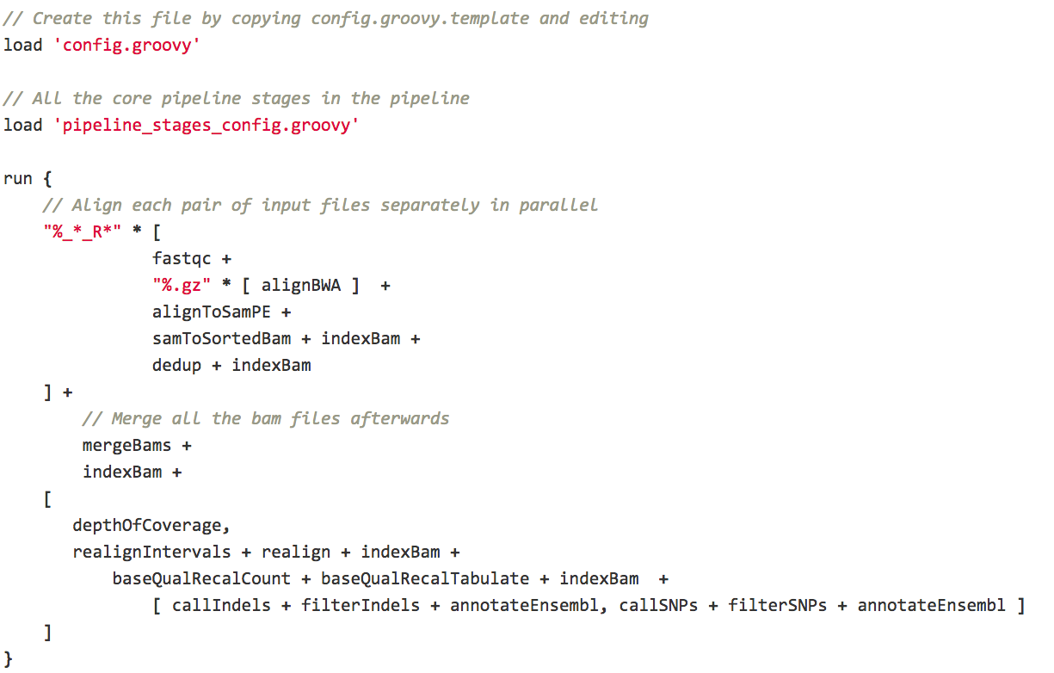
From reads to variants in bpipe
https://github.com/ssadedin/variant_calling_pipeline
Assumes: paired end reads
Assumes: files in form *<sample_name>*_..._R1.fastq.gz, *<sample_name>*_..._R2.fastq.gz

Slide 34
From reads to variants in bpipe
https://github.com/ssadedin/variant_calling_pipeline
Assumes: paired end reads
Assumes: files in form *<sample_name>*_..._R1.fastq.gz, *<sample_name>*_..._R2.fastq.gz

Slide 35
see also: https://bitbucket.org/drambaldi/bpipe_config

Slide 36
bpipe-config: pipelines generator

